Slide 1
BELLS
Customer
Support
Agent
AgentX Platform | Anthropic Claude 4.5 Haiku | RAG
Presented by Sylvester Ang Soon Rong | Cohort 1
SCTP Agentic AI Course

Slide 2
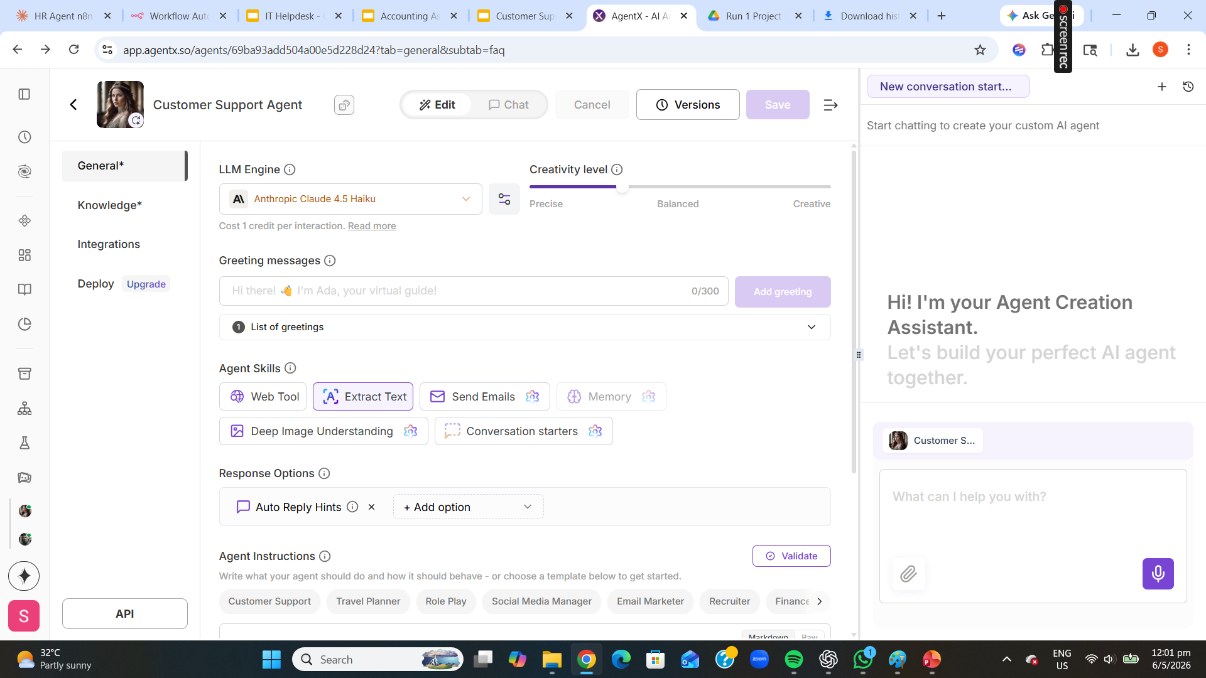
Customer
Support
Agent
An AI-powered Customer Support Agent built on AgentX that assists customers by retrieving information from uploaded FAQ knowledge documents and providing contextual support responses.
Features:
• AI-powered customer support
• Retrieval-Augmented Generation (RAG)
• FAQ knowledge retrieval
• Live conversational assistance
• Context-aware responses
• Reduced hallucination via knowledge grounding

Slide 3
Sample
Workflow
• Anthropic Claude 4.5 Haiku LLM
• Creativity level: Precise
• Web Tool + Extract Text enabled
• Auto Reply Hints configured
• AI-powered support workflow

Slide 4
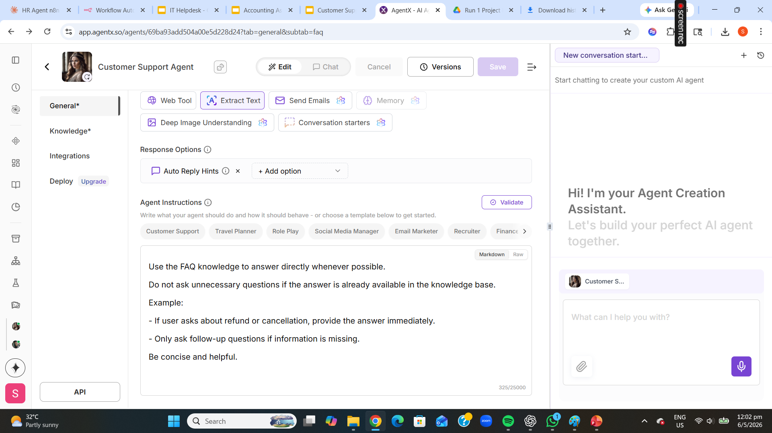
Sample
Agent
Instructions
• Use FAQ knowledge to answer directly
• Avoid unnecessary follow-up questions
• Provide concise, helpful responses
• Only ask follow-up if info is missing
• Be concise and helpful

Slide 5
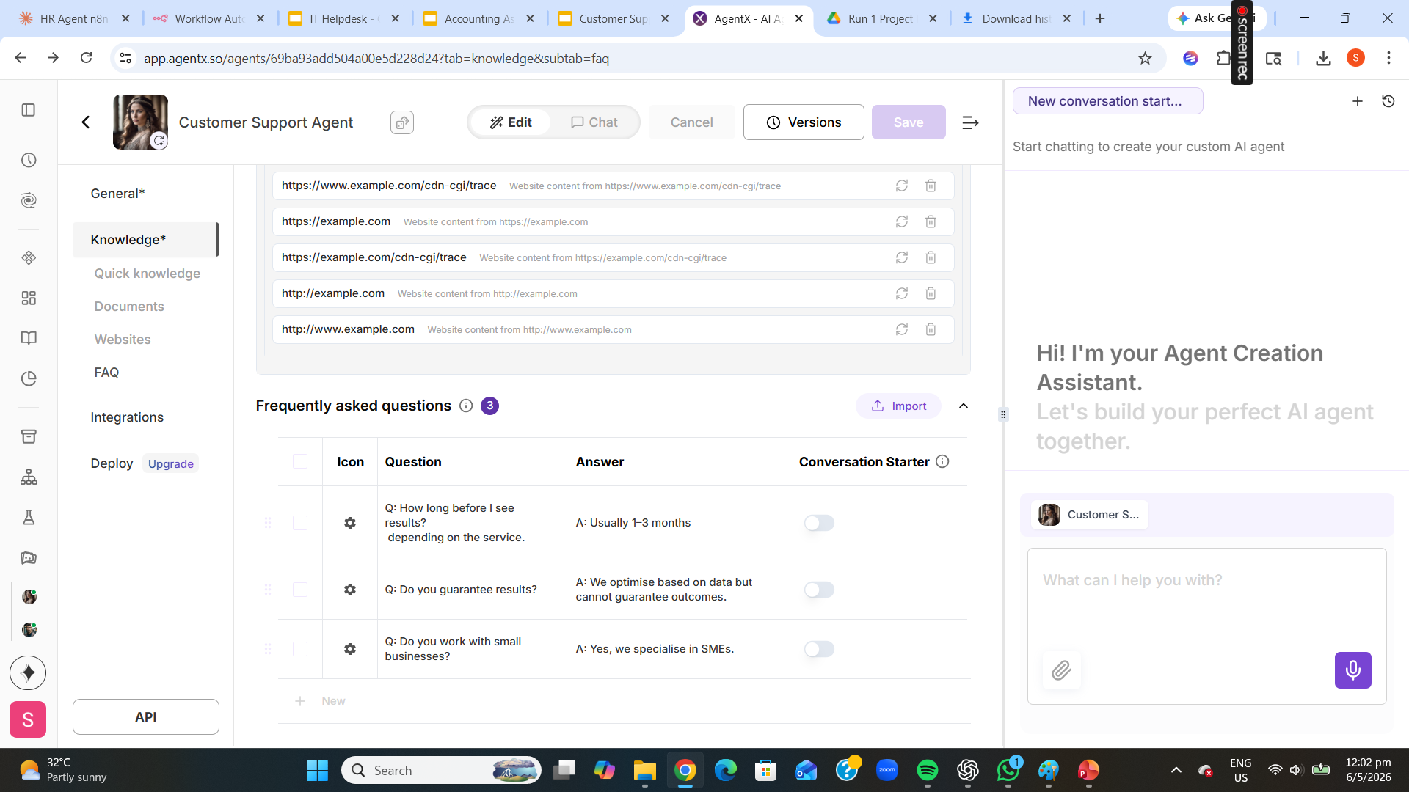
Sample
Knowledge
Base
• FAQ document uploaded as knowledge source
• Frequently asked questions configured
• RAG retrieves relevant info per query
• Reduces hallucination significantly
• Improves response accuracy
• Contextual customer support enabled

Slide 6
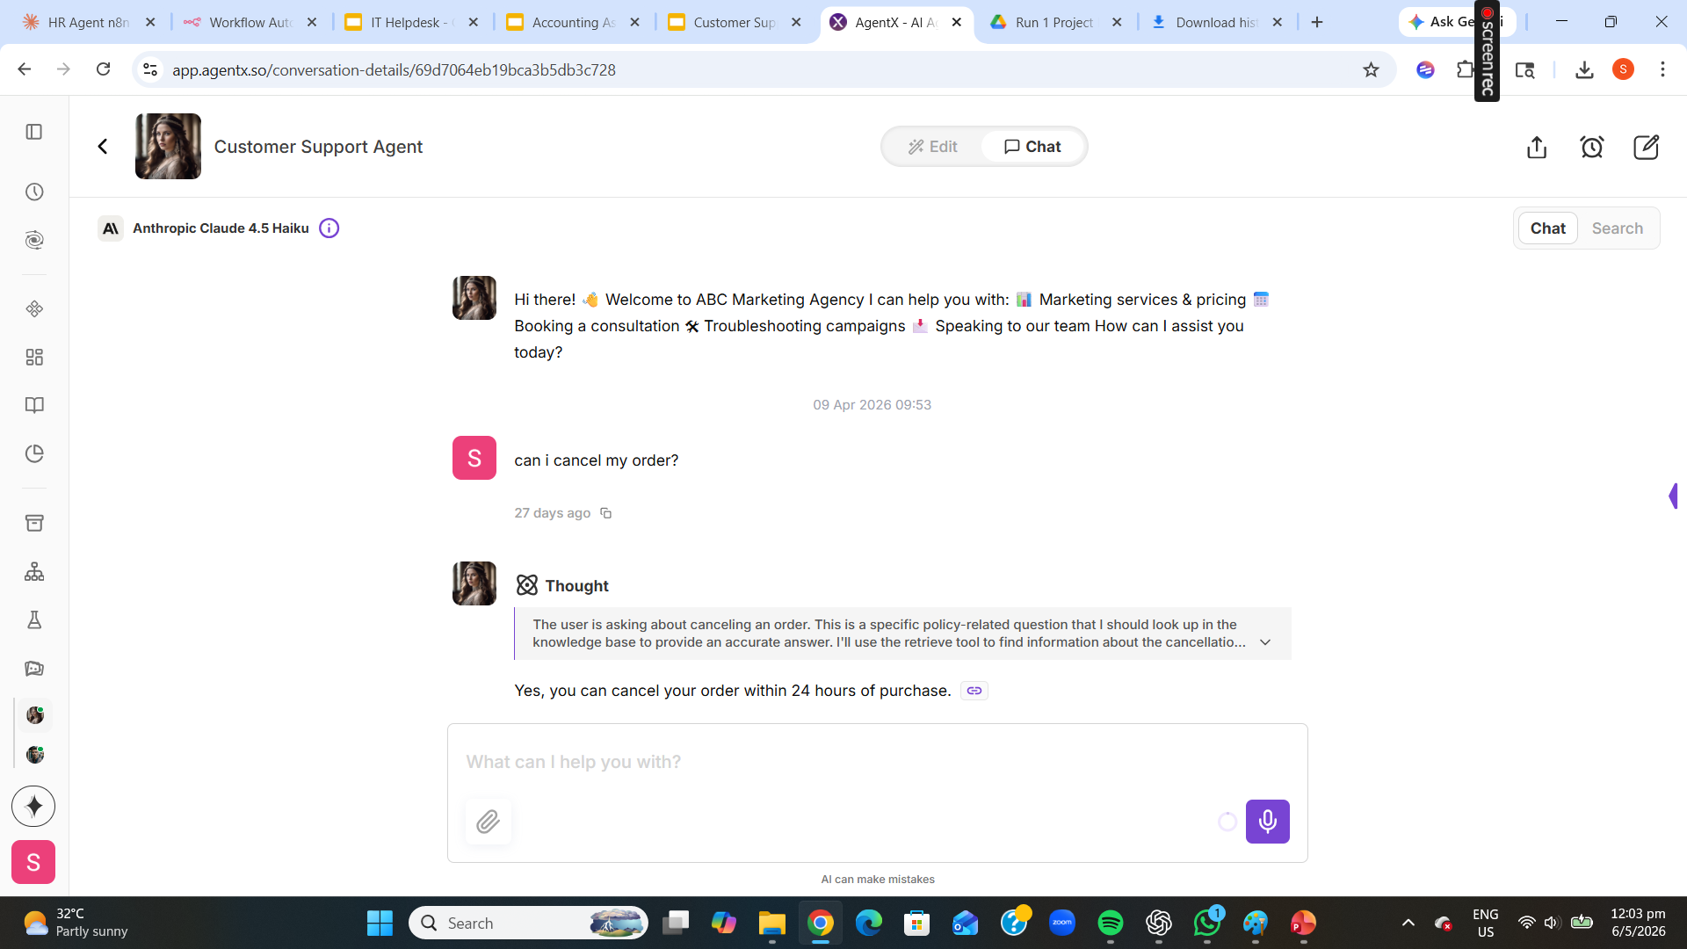
Sample
Live Chat
Interaction
• User asks: 'Can I cancel my order?'
• Agent Thought process shown
• Queries FAQ knowledge base (RAG)
• Instant answer: within 24 hours
• Powered by Claude 4.5 Haiku

Slide 7
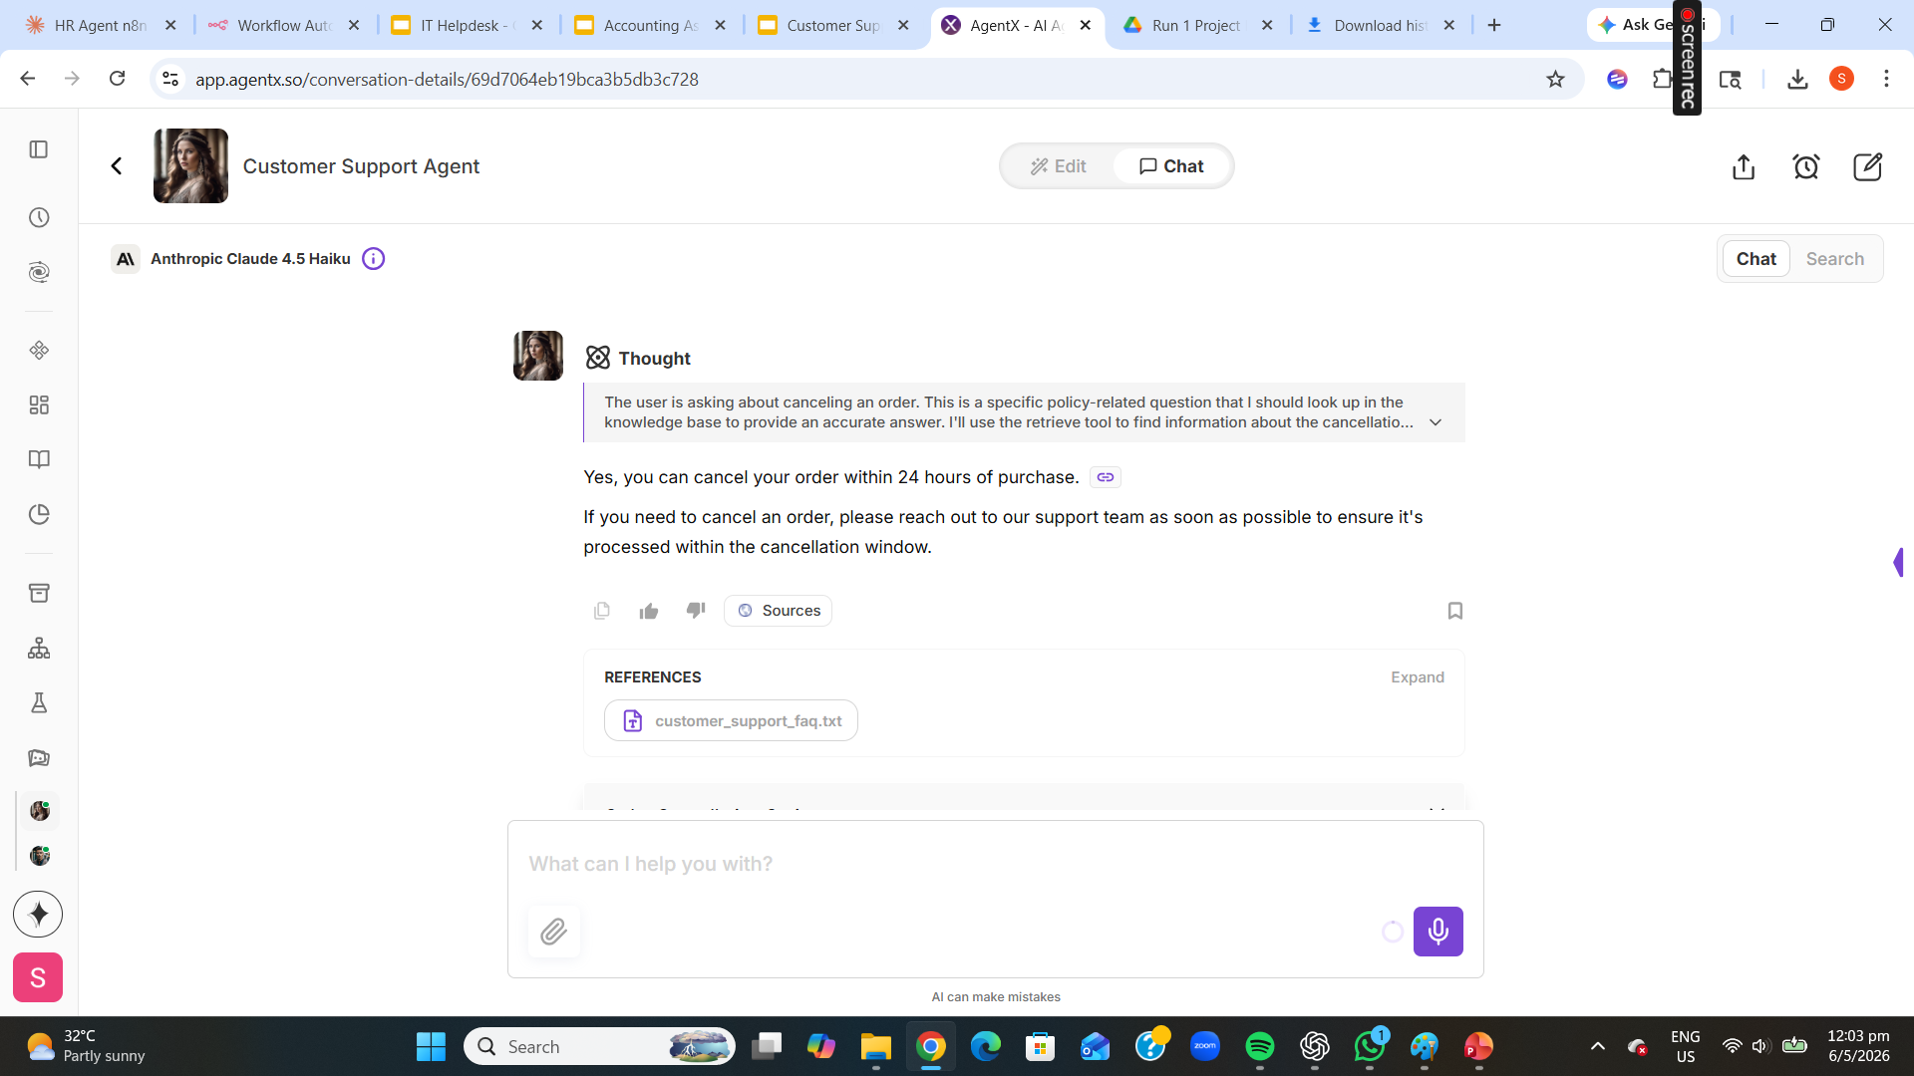
Sample
AI Response
• AI retrieves FAQ knowledge reference
• Cites source: customer_support_faq.txt
• Accurate cancellation policy answer
• References displayed transparently
• RAG-based contextual reasoning

Slide 8
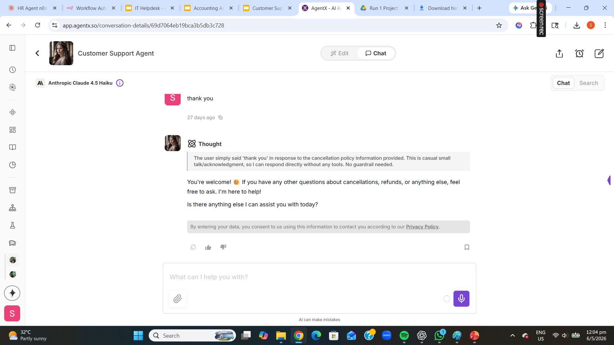
Sample
Conversational
Continuity
• Maintains full conversational context
• Handles follow-up interactions naturally
• Human-like customer engagement
• Responds warmly to casual messages
• Continuous AI-assisted support flow

Slide 9
Technologies
Used
AgentX Platform
Claude 4.5 Haiku
RAG Knowledge Retrieval
Cloud-based AI agent builder — no-code rapid deployment
Anthropic LLM — precise, fast, cost-efficient responses
FAQ-grounded answers — retrieves relevant info per query
Prompt Engineering
FAQ Knowledge Base
AI Conversational Interface
Concise instructions: use FAQ, avoid unnecessary questions
Customer support FAQs uploaded as the knowledge source
Live chat for real-time contextual customer assistance

Slide 10
Thank
You
Conclusion
• Successfully developed AI-powered Customer Support Agent
• Implemented RAG-based FAQ retrieval on AgentX platform
• Demonstrated contextual, knowledge-grounded AI responses
• Maintained multi-turn conversational continuity naturally
• Improved customer assistance efficiency and accuracy
Sylvester Ang Soon Rong · Cohort 1 · SCTP Agentic AI Course

